Slide 1
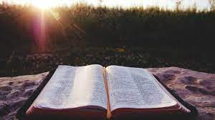

Happy Sabbath

Slide 2
Happy Sabbath
Opening Hymn:
185: Jesus is All the World to Me

Slide 3
Happy Sabbath
Welcome

Slide 4
Happy Sabbath
Scripture Reading:
John 1:1

Slide 5
Happy Sabbath
Story:
Through tears, hope

Slide 6
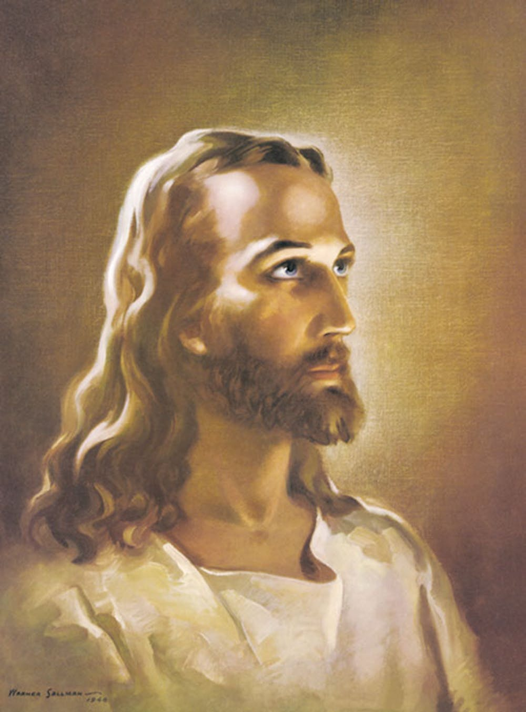
The Word:
In The Flesh
John 1:1-50

Slide 7
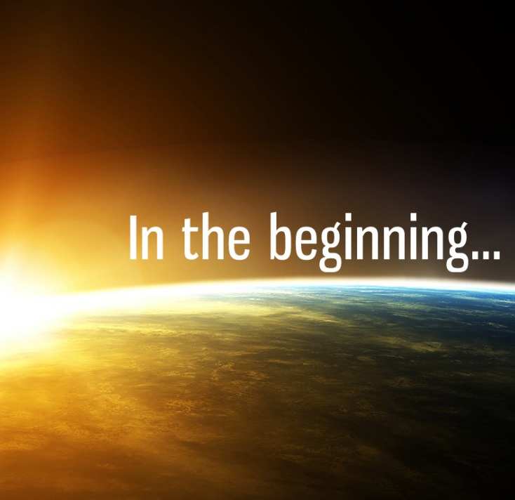

In the beginning God created the heavens and the earth. - Genesis 1:1
In the beginning was the Word and the Word was with God and the Word was God. - John 1:1

Slide 8
The Gospel of John

Slide 9
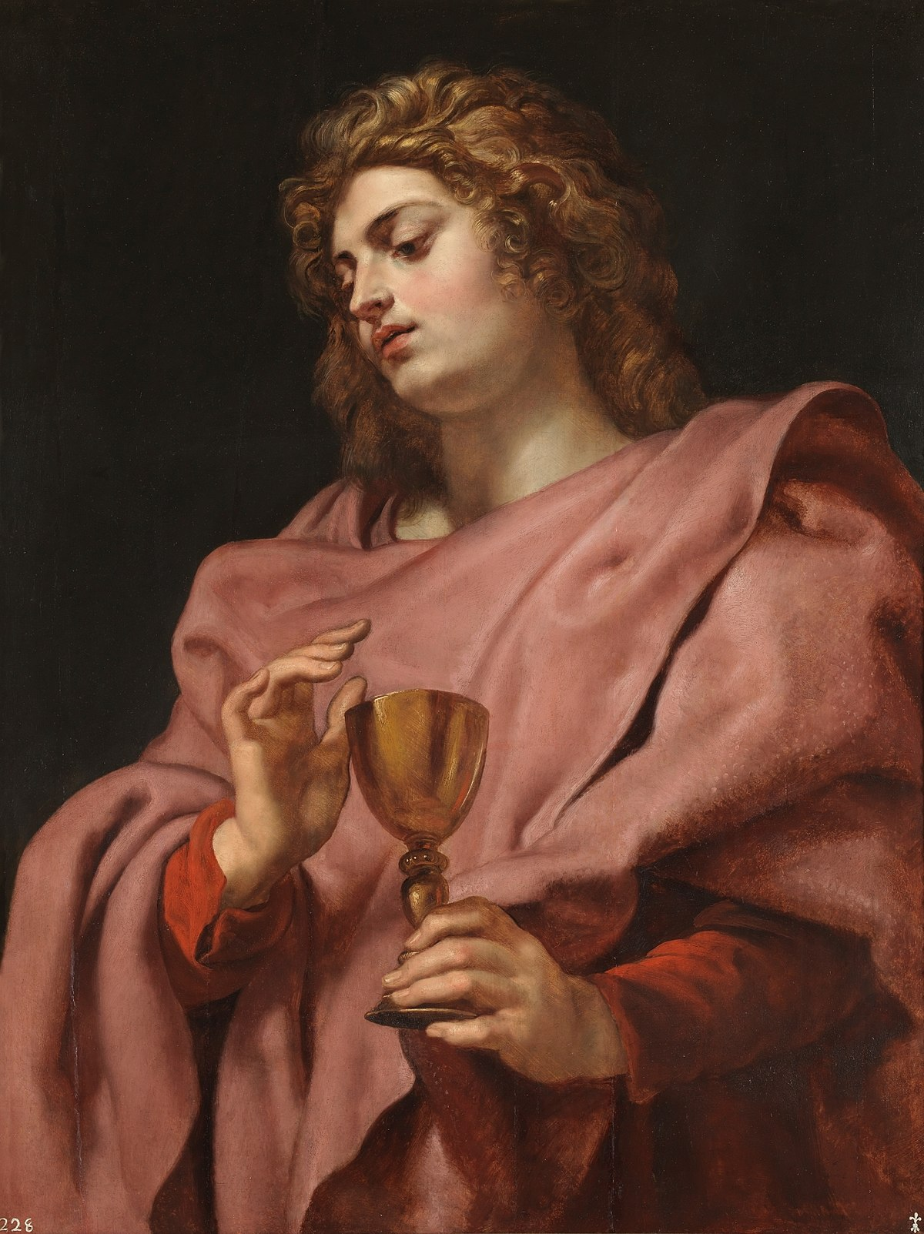
The Apostle John
The Apostle John was the son of Zebedee
The Gospel was written in approximately 90 AD
Written in Ephesus on the shores of the Aegean Sea in modern day Turkey

Slide 10
The Apostle John
Apostle John never calls himself by name, only calls himself the Beloved One
Apostle John lived the longest of all the Apostles and died in approximately 98 AD*
Apostle John was the only Apostle who didn't die as a martyr
*Disputed by some scholars who feel he may have lived into the 2nd century AD.

Slide 11
The Apostle John
He wrote The Gospel of John, three Epistles, and The Revelation of Jesus Christ (through divine inspiration)​
John tells the story of Jesus in a different way than the other Gospel writers​
He is the only one to tell us of the Miracle of Water into Wine

Slide 12
The Apostle John
Apostle John repeatedly calls Jesus the Lamb of God
The Gospel of John contains some of the most quoted verses in the New Testament, especially John 3:16 which is well known by many in popular culture
For God so loved the world that He gave His only begotten Son, that whoever believes in Him should not perish but have everlasting life. John 3:16 (NKJV)
Let us now explore The Gospel of John

Slide 13
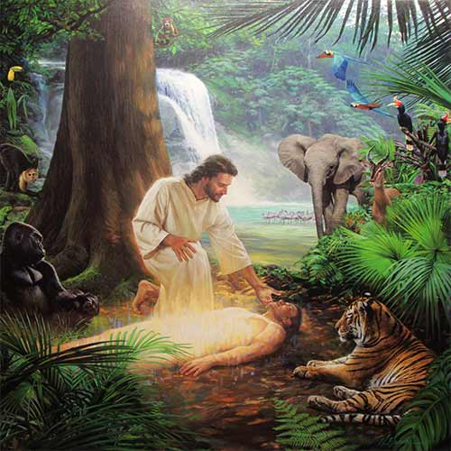
John 1:1-4
1 In the beginning was the Word, and the Word was with God, and the Word was God.
2 He was with God in the beginning.
3 Through him all things were made; without him nothing was made that has been made.
4 In him was life, and that life was the light of all mankind.

Slide 14
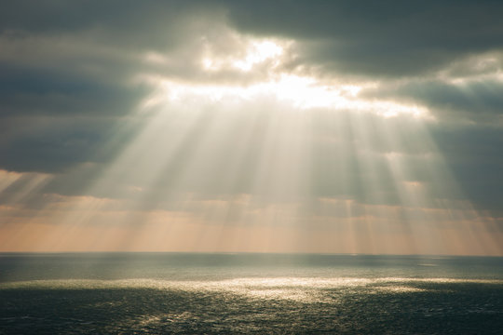
John 1:5
And the light shines in the darkness and the darkness did not comprehend it.

Slide 15
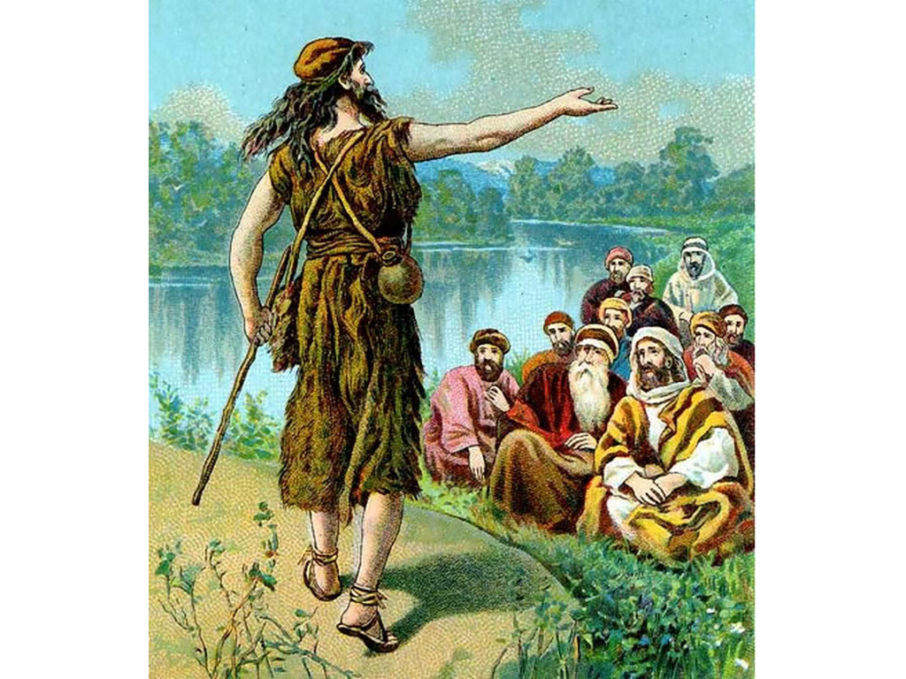
John's Witness: The True Light
John 1:6-13

Slide 16
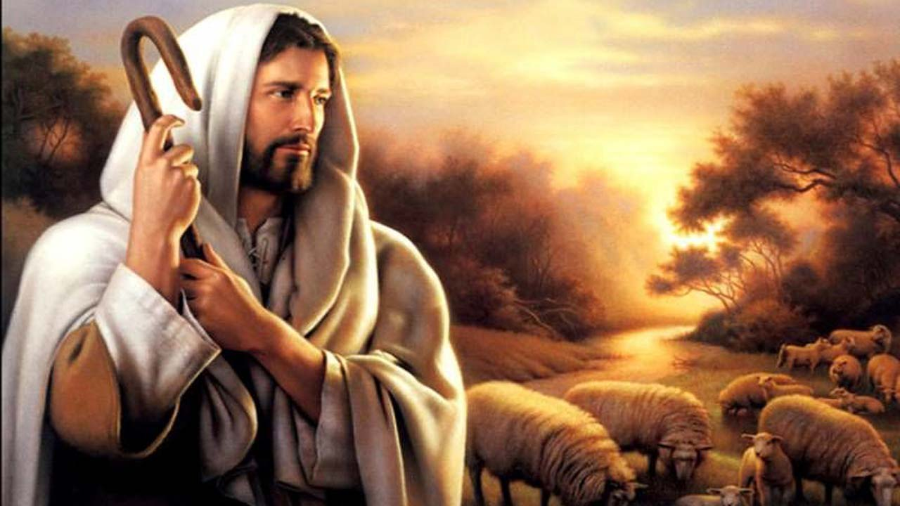
John 1:14
And the Word became flesh and dwelt among us, and we beheld His glory, the glory as of the only begotten of the Father, full of grace and truth.

Slide 17
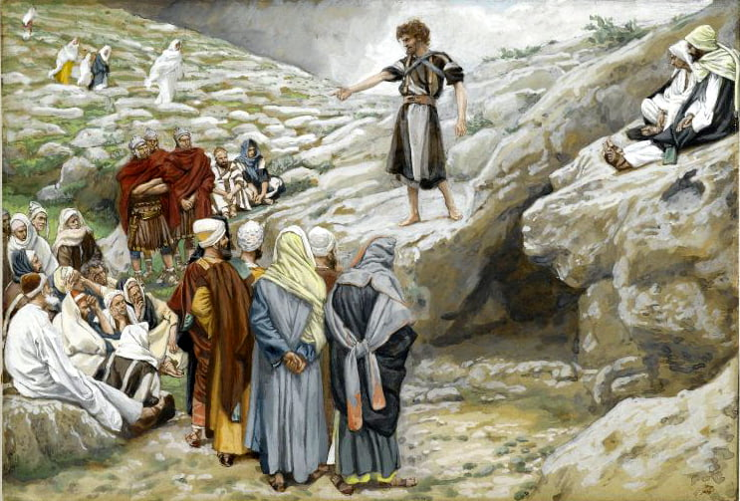
A Voice in the Wilderness
(John 1:19-28)
John the Baptist is not the light, and but Jews sent priests to question him.
John tells them I am , "The voice of one crying in the wilderness; Make straight the way of the Lord." (Isaiah 40:3)

Slide 18
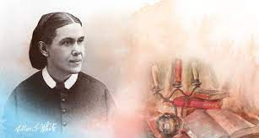
John proclaimed the coming of the Messiah, and called the people to repentance. As a symbol of cleansing from sin, he baptized them in the waters of the Jordan. Thus by a significant object lesson he declared that those who claimed to be the chosen people of God were defiled by sin, and that without purification of heart and life they could have no part in the Messiah's kingdom.
-Desire of Ages 104.4
Ellen G White
1827 - 1915

Slide 19
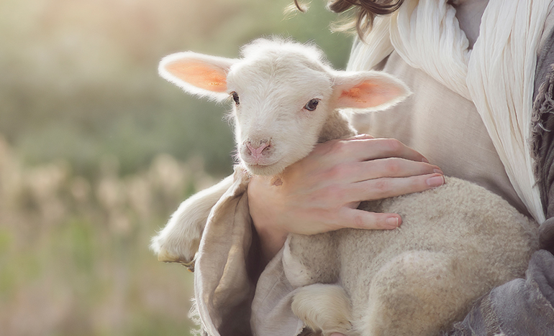
The Lamb of God

Slide 20
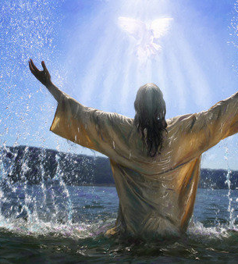
The next day John declares: "Behold the Lamb of God who takes away the sin of the world!
John 1:29-34

Slide 21
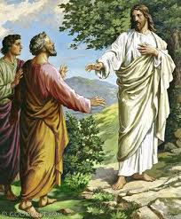
The First Disciples
And the next day, John stood with two of his disciples. And looking at Jesus as He walked, he said, "Behold the Lamb of God!" The two disciples heard him speak, and they followed Jesus. - John 1:35-36

Slide 22
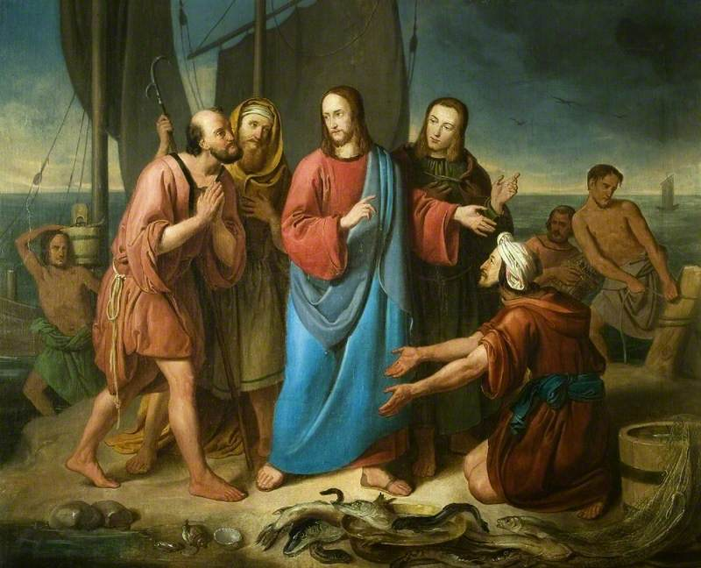
Christ calls His first disciples beginning with Andrew, who was Simon Peter's brother and John. Next was Simon Peter, who was introduced by his brother. Followed by Phillip, Nathanael and the rest of the disciples.
Jesus' first followers are now complete, but He wasn't quite ready to begin His ministry.
John 1:37 - 42

Slide 23
The Word:
The Wedding Feast
John 2:1-12

Slide 24
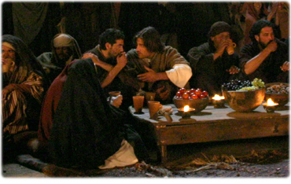
John 2:1-3
On the third day there was a wedding feast in Cana of Galilee, and the mother of Jesus was there.
Now both Jesus and His disciples were invited to the wedding.
And when they ran out of wine, the mother of Jesus said to Him, "they have no wine."

Slide 25
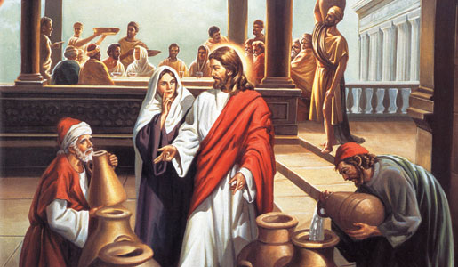
John 2:4
Jesus says to her, "Woman, what does your concern have to do with Me? My hour has not yet come."

Slide 26
This answer, abrupt as it seems to us, expressed no coldness or discourtesy. The Saviour's form of address to His mother was in accordance with Oriental custom. It was used toward persons to whom it was desired to show respect. Every act of Christ's earthly life was in harmony with the precept He Himself had given, "Honor thy father and thy mother." Exodus 20:12. On the cross, in His last act of tenderness toward His mother, Jesus again addressed her in the same way, as He committed her to the care of His best-loved disciple. Both at the marriage feast and upon the cross, the love expressed in tone and look and manner interpreted His words. Desire of Ages 146.4
Ellen G White
1827 - 1915

Slide 27
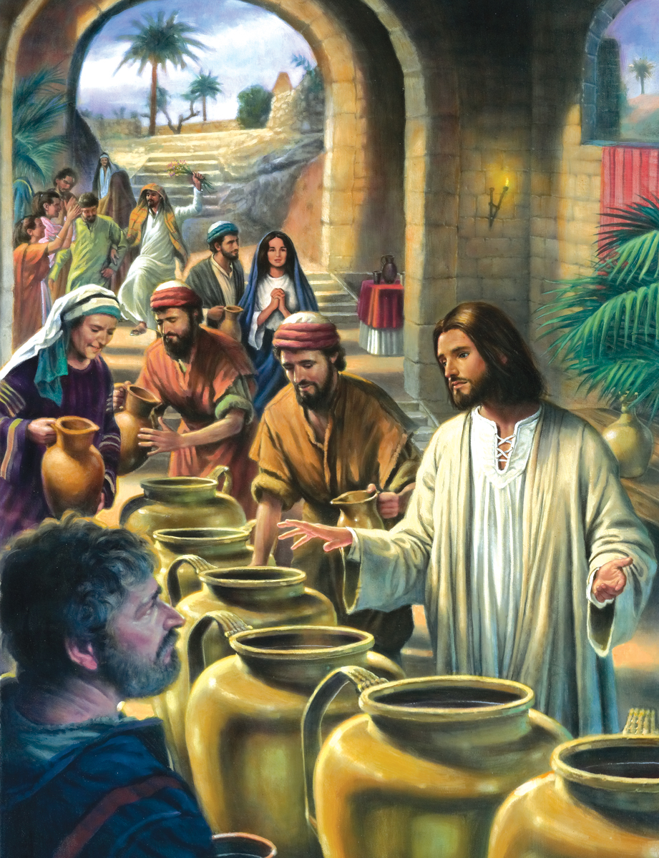
John 2:5-8
His mother says to the servant, "Whatever He says to you, do it."
Now there were set there six waterpots of stone, according to the manner of purification of the Jews, containing twenty or thirty gallons apiece.
Jesus said to them, "Fill the waterpots with water." And they filled them up to the brim.
And He said to them, "Draw some out now, and take it to the master of the feast."

Slide 28
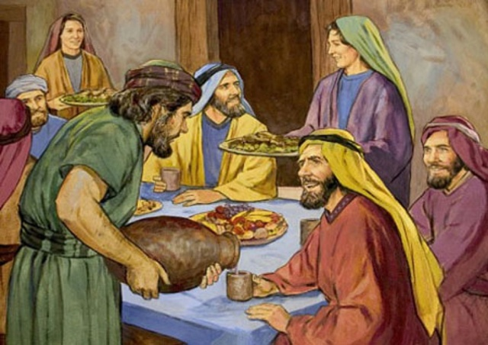
John 2:9-10
When the master of the feast had tasted the water that was made wine, and did not know where it came from (but the servants who had drawn the water knew), the master of the feast called the bridegroom.
And he said to him, "Everyman at the beginning sets out the good wine, and when the guest have well drunk, then the inferior. You have kept the good wine until now."

Slide 29
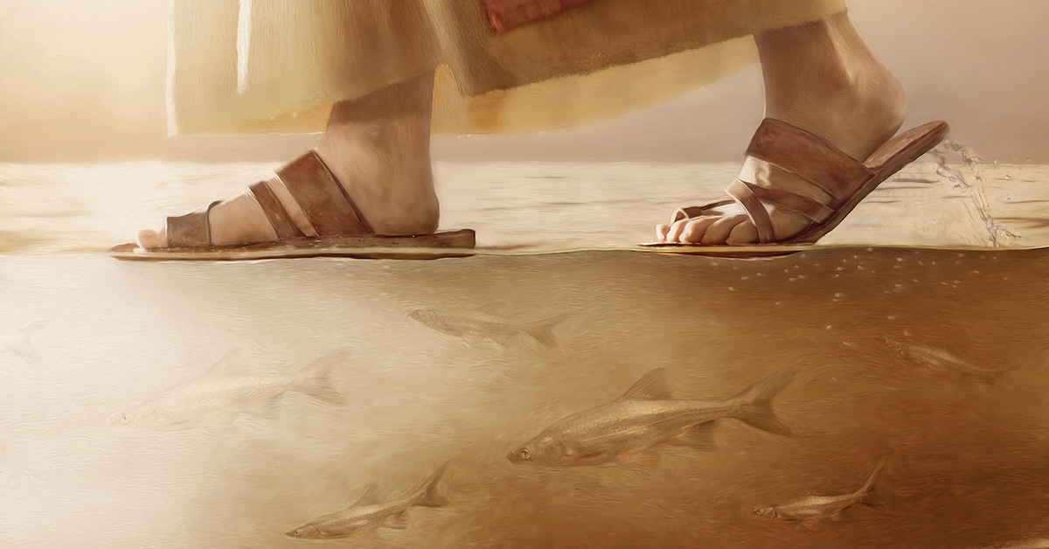
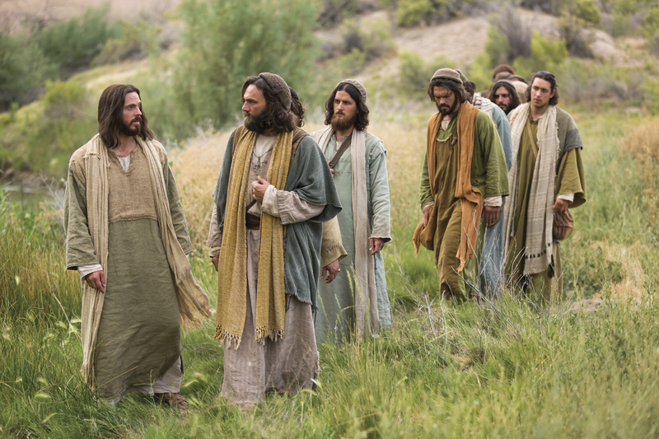
John 2:11-12
This is the beginning of signs Jesus did in Cana of Galilee, and manifested in HIs glory; and His disciples believed in Him
After this He went down to Capernaum, He, His mother, His brothers, and His disciples; and they did not stay there many days.

Slide 30
The Word:
Jesus Cleanses the Temple
John 2:13-22

Slide 31
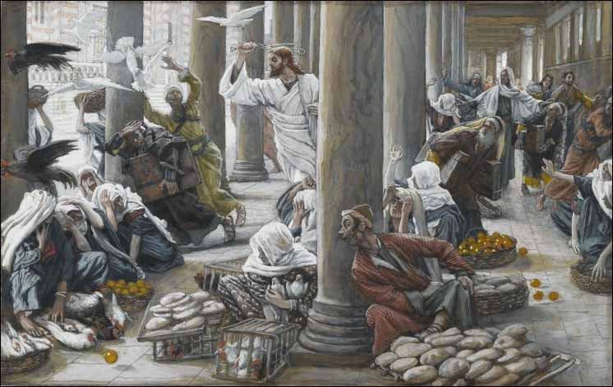
John 2:14
And He found in the temple those who sold oxen and sheep and doves, and the money changes doing business.

Slide 32
John 2:15-16
When He had made a whip of cords, He drove them all out of the temple, with the sheep and the oxen, and poured out the changers' money and overturned the tables.
And He said to those who sold doves, "Take these things away! Do not make my father's house a house of merchandise!

Slide 33
John 2:17-18
Then His disciples remembered that it was written, "Zeal for Your house has eaten Me up."
So the Jews answered and said to Him, "What sign do You show to us, since You do all these things?"

Slide 34
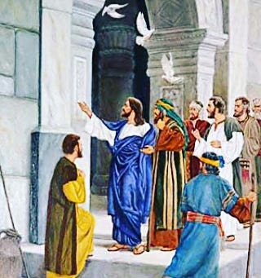
John 2:19
Jesus answered and said to them, "Destroy this temple, and in three days I will raise it up."

Slide 35
Jesus did not design that the skeptical Jews should discover the hidden meaning of his words, nor even his disciples at that time. After his resurrection they called to mind these words he had uttered, and they then understood them correctly. They remembered that he had also said that he had power to lay down his life and to take it again. Jesus was acquainted with the path his feet had entered upon, even unto the end. His words possessed a double meaning, referring to the temple at Jerusalem as well as his own material body. Spirit of Prophecy Vol 2 122.1
Ellen G White
1827 - 1915

Slide 36
Christ was the foundation and life of that temple. His crucifixion would virtually destroy it, because its services were typical of the future sacrifice of the Son of God. They pointed to the great antitype, which was Christ himself. When the Jews should accomplish their wicked purpose, and do unto him what they listed, from that day forth sacrificial offerings, and the services connected with them, would be valueless in the sight of God, for type would have met antitype in the perfect offering of the Son of God. ​SSpirit of Prophecy Vol 2 122.2
Ellen G White
1827 - 1915

Slide 37
John 2:20-22
Then the Jews said, "It has taken forty-six years to build this temple, and You will raise it up in three days?"
But He was speaking of the temple of His body,
Therefore, when He had risen from the dead, His disciples remembered that He had said this to them; and they believed the Scripture and the word which Jesus had said.

Slide 38
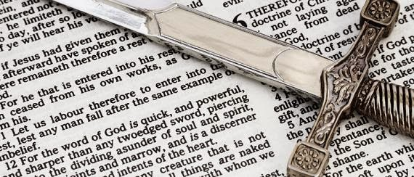
The Discerner of Hearts
John 2:23-25

Slide 39

John 2:23-25
Now when He was in Jerusalem at the Passover, during the feast, many believed in His name and when they saw the signs which He did.
But Jesus did not commit Himself to them, because He knew all men,
And had no need that anyone should testify of man, for He knew what was in man.

Slide 40
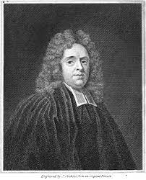
Our Lord knew all men, their nature, dispositions, affections, designs, so as we do not know any man, not even ourselves. He knows his crafty enemies, and all their secret projects; his false friends, and their true characters. He knows who are truly his, knows their uprightness, and knows their weaknesses. We know what is done by men; Christ knows what is in them, he tries the heart. Beware of a dead faith, or a formal profession: carnal, empty professors are not to be trusted, and however men impose on others or themselves, they cannot impose on the heart-searching God.
Matthew Henry Concise Bible Commentary Pg 1850
Matthew Henry
1662 to 1714

Slide 41
To be continued...

Slide 42
Happy Sabbath
Closing Hymn:
245: More About Jesus

Slide 43
Happy Sabbath
Closing Prayer

Slide 44
Happy Sabbath

